Slide 1
Panorama Synthesis
Hrishikesh Deshmukh

Slide 2
Development Platform
OpenCV 2.4.13
Visual Studio 2015
Visual C++
C#

Slide 3
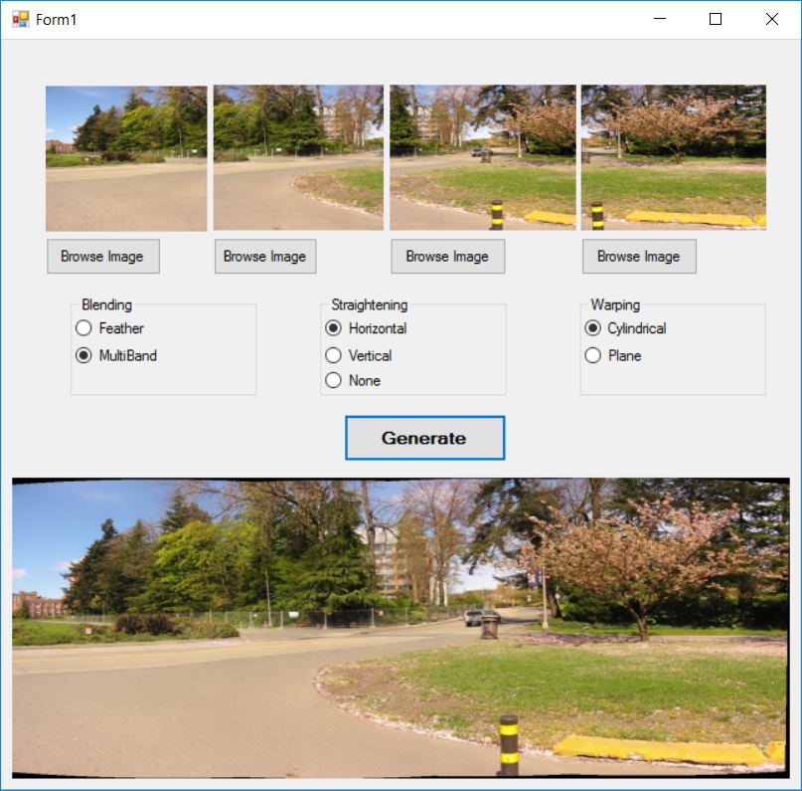
User Interface

Slide 4
Flow
Input Sequential Images
Feature Detection
Feature Matching
bundle Adjustment
Straightening
Warping
Blending

Slide 5
Flow Explained
Feature Detection
uses SURF feature detector provided by OpenCV
SurfFeatureFinder() detects features form the image
Feature Matching
Uses OpenCV’s BestOf2NearestMatcher
Finds 2 nearest matches, keeps best one
Bundle Adjustment
calculates rotational ratio of camera rotation and camera positions
Straightening
Re-rotates the stitched images to the linear level
Warping
Warps the stitched image in different shapes
For e.g. Cylindrical, plane, fisheye
Blending
Feather Blend
Multiband Blend

Slide 6
Demo

Slide 7
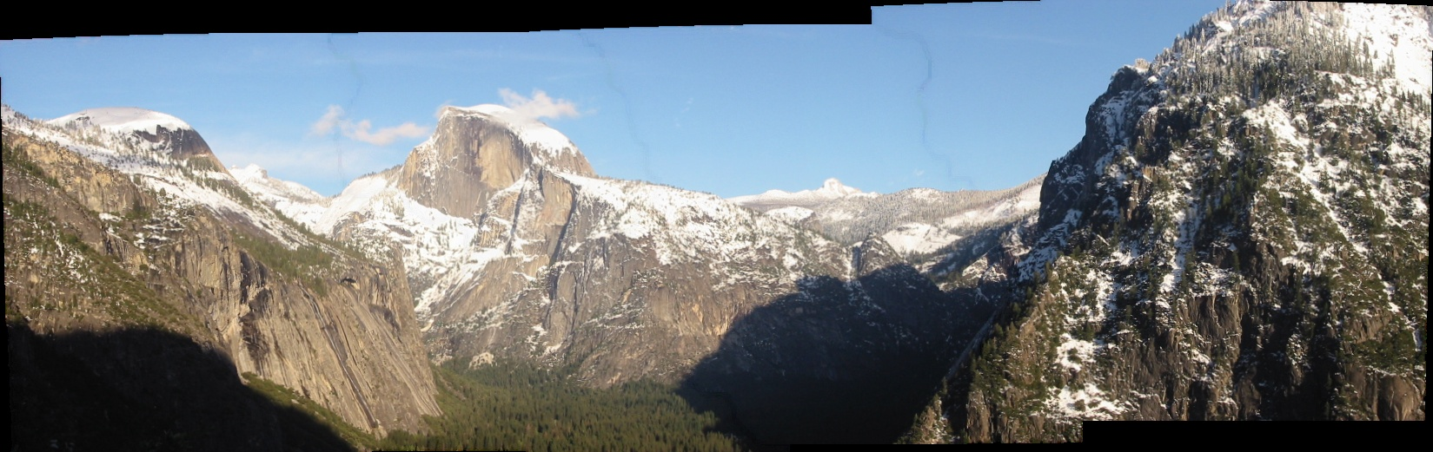
Blending
Feather Blend
Visible lines at blending points
No loss in contrast of the original image

Slide 8

BLENDING
Multiband Blend
Smooth blending
Slight loss in contrast of the original image

Slide 9
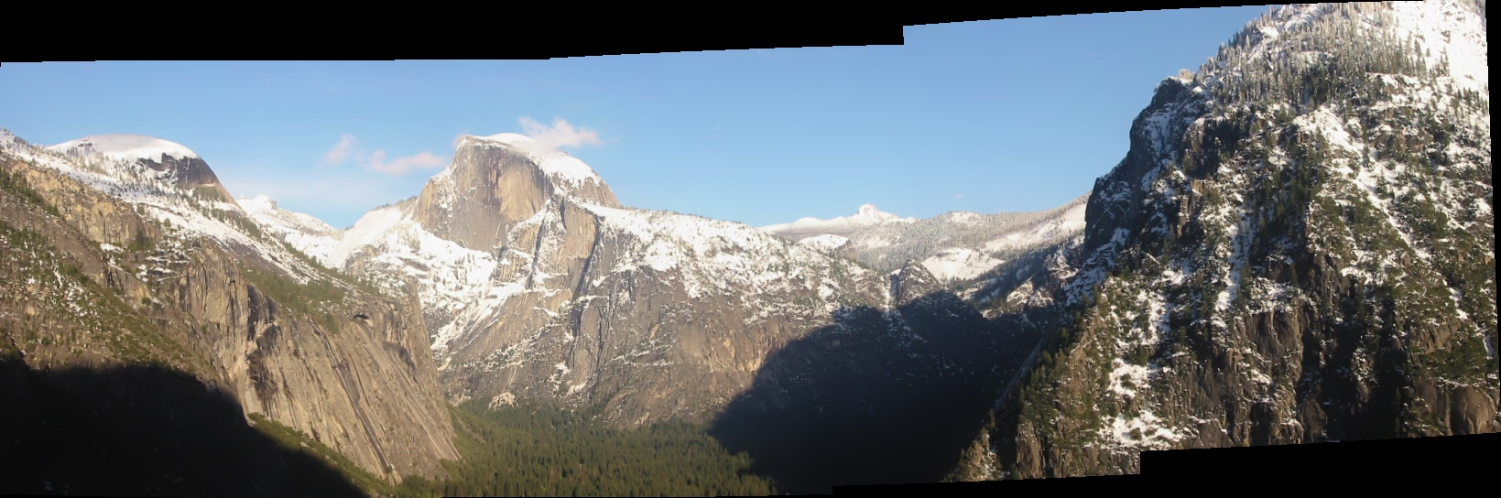
Straightening

Slide 10
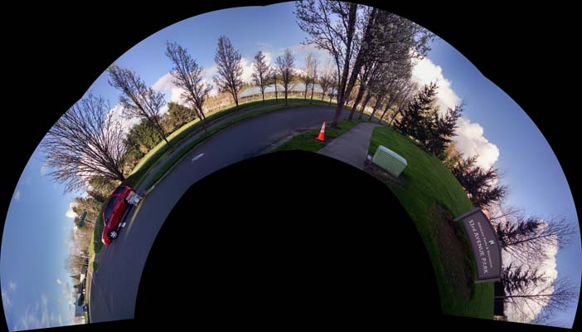
Some More Experiments

Slide 11
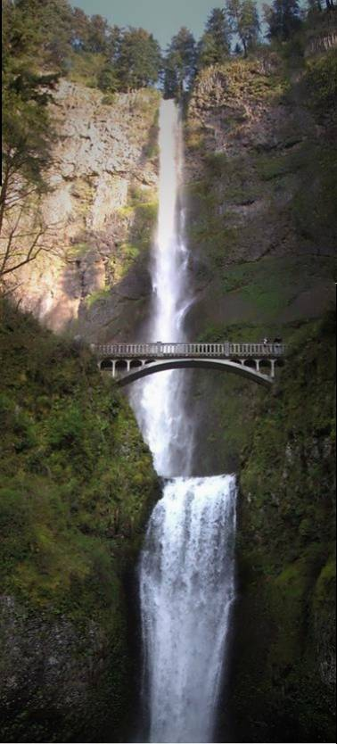

Slide 12
References
http://www.tqcto.com/article/internet/256933.html
http://www.pyimagesearch.com/2016/01/11/opencv-panorama-stitching/
http://docs.opencv.org/2.4/modules/stitching/doc/introduction.html

